Slide 1

Department of Computer Science &Engineering Artificial Intelligence & Machine Learning
A.P. Shah Institute of Technology G.B.Road,Kasarvadavli, Thane(W), Mumbai-400615
UNIVERSITY OF MUMBAI
Academic Year 2023-2024

Slide 2

House Price Predictor
Computer Science & Engineering Artificial Intelligence and Machine Learning
By
Khushi Dhargawe (21106007)
Mansi Ghanwat(21106028)
Shreyash Gharge (21106063)
Prabudh Gaikwad (21106038)
Under the Guidance of Prof. M C Pawaskar

Slide 3
Index
Introduction
Objectives
Literature survey
Block Diagram
Tools/Softwares, Languages used
Conclusion
References

Slide 4

INTRODUCTION
A price predictor is a valuable tool used for forecasting and estimating the value of a specific item or asset, particularly in the context of real estate.
These tools leverage machine learning algorithms to analyze various property features, including location, size, amenities, and historical pricing trends.
Machine learning models used in price prediction aim to capture the complex relationships between input features and the target variable (house price) to generate reliable estimates

Slide 5
Objective
Develop a model that gives reliable estimates of house prices.
Help buyers and sellers make informed decisions about property values.
Assist lenders in evaluating the risk associated with providing loans for houses.
Contribute to understanding trends and patterns in property values for market analysis
Create easy-to-use tools for users to input property details and get instant price estimates.

Slide 6
Literature Survey
Sr. No | Title | Author Name | Description
1. | House Price Prediction Using Machine Learning | G. Naga Satish, Ch. V. Raghavendran, M.D.Sugnana Rao, Ch.Srinivasulu | A model has been developed to provide users with a new approach to future lodging value predictions. The model uses relapse strategies and gradient boosting to ensure more sensible predictions. However, there are potential upgrades due to time constraints and the stacking period. Using multiple processors and parallel computations could potentially decrease preparation time and prediction period. The model also offers options for clients to select a district for high temperature maps instead of entering the list.
2. | House Price Prediction Using Machine Learning | ANAND G. RAWOOL1 , DATTATRAY V. ROGYE2 , SAINATH G. RANE3 , DR. VINAYK A. BHARADI4 | The paper entitled “House Price Prediction Using Machine Learning” has presented to predict house price based on various features on given data. From our analysis we set value of RMSE as 2.9131889. In this model we have to add additional features like tax, air quality so it become different from other prediction system. It helps people to buy house in budget and reduce loss of money.

Slide 7
Literature Survey
Sr. No | Title | Author Name | Description
3. | House Prices Prediction with Machine Learning Algorithms | Chenchen Fan, Zechen Cui, Xiaofeng Zhong | Based on the data set compiled by D. D. Cock and the competition run by kaggle.com, we propose a house prices prediction algorithm in Ames, lowa by deliberating on data processing, feature engineering and combination forecasting. Our prediction ranks the 35th of the total 2221 results on the public leaderboard of Kaggle.com and the RMSE of predicted results after taking logarithm from all the test data is 0.12019, which shows good performance and small of over-fitting.
4. | Predicting property prices with machine learning algorithms | siu wai wong, Bo-Sin Tang | This study explores the use of machine learning algorithms in property research, comparing three models: stochastic gradient descent (SGD), random forest (RF), and gradient boosting machine (GBM). The results show that advanced algorithms can accurately predict housing prices, with RF and GBM generating more accurate estimates with lower prediction errors. However, the study acknowledges limitations, such as the need for careful feature selection, computational time, and the need for additional data.

Slide 8
BLOCK DIAGRAM

Slide 9
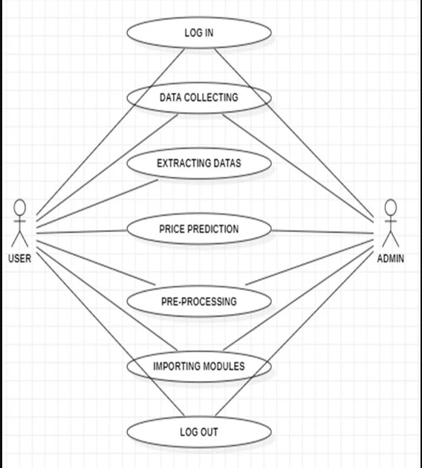

Slide 10
Tools/softwares, Languages used
Python
Machine learning
Python librarys

Slide 11
Conclusion
House price predictors, driven by machine learning, are crucial in real estate.
They provide accurate estimates by analyzing factors like location, size, amenities, and historical pricing trends.
Buyers and sellers benefit from these predictors for making well-informed decisions.
Lenders use them to evaluate loan risks, while investors assess potential returns on investment.
House price predictors contribute to market analysis, offering insights into trends and dynamics shaping property values.

Slide 12
References
David E. Rapach , Jack K. Strauss “ Forecasting real housing price growth in the Eighth District states” .
Vasilios Plakandaras+ and Theophilos◻, Rangan Gupta*, Periklis Gogas “Forecasting the U.S. Real House Price Index” .
Gupta and Das (2010) Forecasting the US Real House Price Index: Structural and Non-Structural Models with and without Fundamentals .
Rangan Gupta “Forecasting US real house price returns over 1831– 2013: evidence from copula models”

Slide 13
Thank you

